Slide 1




Centering Community Voices to Advance Behavioral Health Equity: Findings from the Evaluation of the Community Prevention and Wellness Initiative
Presented by
Gitanjali Shrestha, PhD, Konul Karimova, MA, & Heather Terral, PhD
Washington State University
October 24, 2023
Notes:
4:15 pm to 5:00 pm
From Johanna - Please keep this in mind as we will have about eighty virtual attendees attending the Prevention Summit. Please acknowledge them at the start of your presentation.
Good afternoon everyone, and thank you joining us in person and joining us virtually. My name is Gitanjali Shrestha, and I am a Research Assistant professor in the Prevention Science program at Washington State University. Today, I am presenting with my colleagues, Heather and Konul and we are excited to talk about the Community Prevention and Wellness Initiative health equity evaluation. [Heather and Konul introductions]

Slide 2

Introductions & Setting the Stage
Notes:
4:15 to 4:30

Slide 3


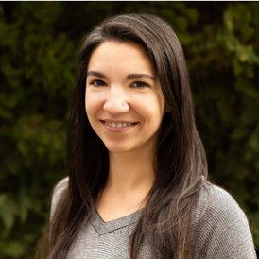
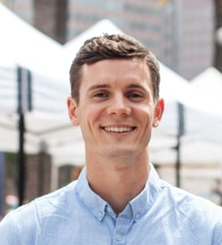
Our team
Jordan Newburg, MA
Graduate Research Assistant
Dept. of Human Development
Washington State University
Brittany Cooper, PhD
Associate Professor
Dept. of Human Development
Washington State University
Clara Hill, MPH
Research Associate
Dept. of Human Development
Washington State University
Tyler Watson, PhD, MPH
Prevention Research & Evaluation Manager
Washington State Health Care Authority
Notes:
4:15 to 4:30
As we begin this presentation, we would like to acknowledge the contribution of our team members. Jordan, Brittany, and Clara are our colleagues from WSU. And Tyler is our colleague from DBHR.

Slide 4

Acknowledgements
Washington State Health Care Authority (HCA)
Community Prevention & Wellness Initiative (CPWI) Communities and Coalition Coordinators
Notes:
4:15 to 4:30
We would also like to take this opportunity to acknowledge Sarah Mariani and her team at the Washington State Health Care Authority for not only funding this evaluation but also for being relentless advocates of prevention in Washington State. We would also like to the thank CPWI coalitions, especially the coalition coordinators for all their hard work, dedication, and passion for prevention.

Slide 5
Today’s Presentation
Part 1: What is the Community Prevention & Wellness Initiative (CPWI) health equity evaluation telling us?
Brief Overview of CPWI and Summary of Findings
Part 2: What does it mean for my prevention work?
Small and large-group discussion
Notes:
Our presentation today will be divided into two parts. The first part will focus on the CPWI framework, and the findings from the health equity evaluation.​
In part two, we will have a group discussion on what all of this means for your prevention work. What are some implications for your work?​
​
We hope to make this an interactive session. So, if you have any questions while we are presenting, please feel free to raise your hand and we’d be happy to answer your questions.​
​

Slide 6
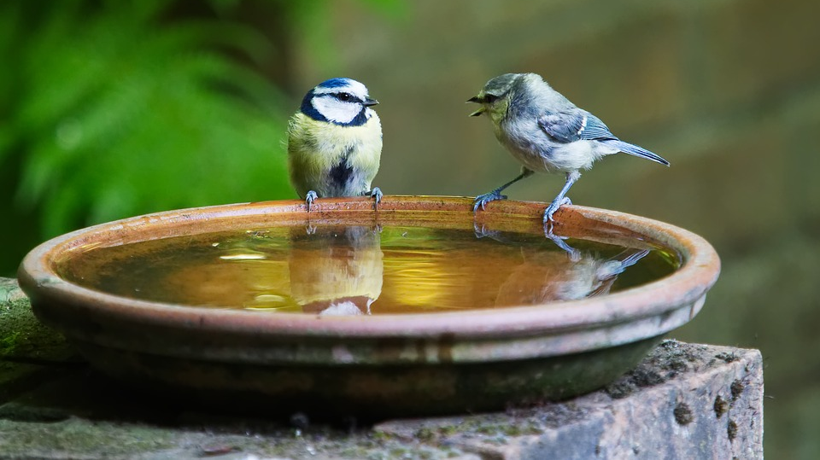
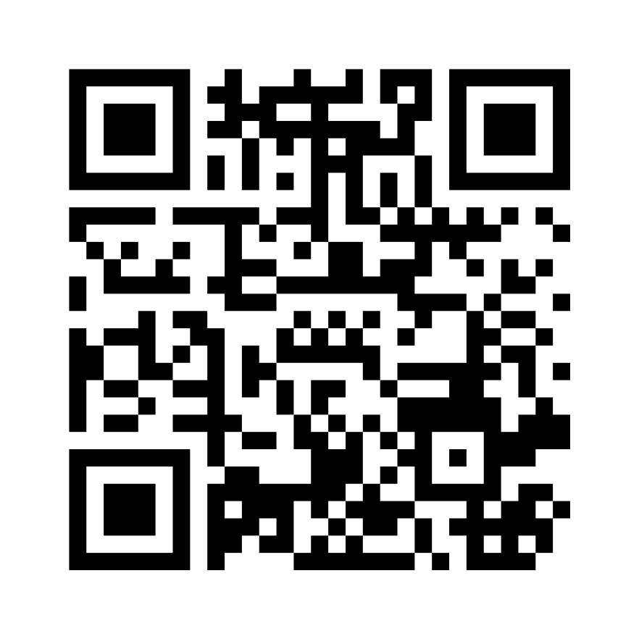
Warm-Up Activity
Scan the QR code with your phone or go to Menti.com and enter code 4985 4158
What does health equity look like in the context of your work?
Notes:
4:15 to 4:30
At maximum, 10 minutes
Mentimeter with word cloud link to display results: https://www.mentimeter.com/app/presentation/alxr2zcw2hnckxxenuf7hk7h7oqvgfuy/sr3ahtjm6rry
Before we talk more about health equity in the context of our project, we would like to do an activity.

Slide 7
Behavioral Health Equity
Leading causes of death are behavioral and preventable
Tobacco
Substance Use
Adolescence: “the first barrier to health promotion.”
As health is socially determined, more privileged groups tend to have more favorable outcomes compared marginalized groups
Closing gaps in adolescent disparities can have impact on adulthood disparities
Adrian, M., Charlesworth-Attie, S., Vander Stoep, A. et al. Health Promotion Behaviors in Adolescents: Prevalence and Association with Mental Health Status in a Statewide Sample. J Behav Health Serv Res 41, 140–152 (2014). https://doi.org/10.1007/s11414-013-9370-y
Kevin Fiscella, Harriet Kitzman; Disparities in Academic Achievement and Health: The Intersection of Child Education and Health Policy. Pediatrics March 2009; 123 (3): 1073–1080. 10.1542/peds.2008-0533
Notes:
The leading causes of death are behavioral and they are preventable. Behavioral health equity is the right of all individuals, regardless of race, age, ethnicity, gender, disability, socioeconomic status, sexual orientation, or geographical location, to access high-quality and affordable healthcare services and support.
Advancing behavioral health equity means working to ensure that every individual has the opportunity to be as healthy as possible.
As health is socially determined, more privileged groups tend to have more favorable outcomes compared to marginalized groups.
Closing the gaps in adolescent disparities can have an impact on adulthood disparities.
--
Why Bx Health Equity is important and why it is important in context of CPWI
This is where we can tackle Objective 1
Leading causes of death are behavioral and preventable
Tobacco
Substance Use
Adolescence: “the first barrier to health promotion.”
Emergence of health-compromising behaviors that incur risk into adulthood

Slide 8

Overview of the Community Prevention and Wellness Initiative (CPWI) and Summary of Findings
Notes:
Now we will be discussing the health equity findings from the evaluation of the Community Prevention and Wellness Initiative. With a show of hands, how many you are familiar with the CPWI initiative?

Slide 9
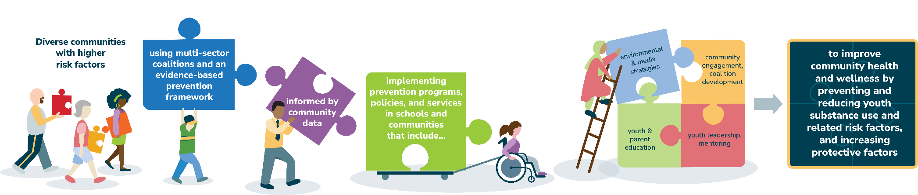
The Washington State CPWI Model
Notes:
4:15 to 4:30.
[Asking attendees if they are familiar with CPWI // show of hands? ]
--
The CPWI is a community-coalition based approach to preventing adolescent substance use. It focuses Washington State’s limited prevention resources within highest need communities in the state.
Previous evaluations of CPWI have shown that this initiative is effective at reducing adolescent substance use and related risk factors, and improving protective factors. The purpose of this evaluation project was to conduct CPWI evaluation using a health equity lens.
--
We used data from the Washington State Healthy Youth Survey to look at prevalence rates of substance use, mental health, and related protective factors. We used a strengths-based approach for this evaluation, we recoded outcomes to reflect “positive outcomes.” For example, “any alcohol use in past 30 days” was recoded as “no alcohol use in past 30 days.” Heather will be discussing the quantitative results.
--
We also interviewed CPWI coalition coordinators to get their more information on health equity work being done in CPWI communities and to understand the facilitators and barriers for this work. Konul will be discussing the qualitative results.
--
--
Conduct inclusive community outreach
Partner with underserved populations
Promote health equity in policy, practices, and resource allocation
Community selection factors include TANF, school drop-out, suicides, drug & alcohol use, economic factors
Different communities have different needs
Coalitions responsible for assessment, planning, implementation, evaluation
Build community capacity for implementing & sustaining programs

Slide 10
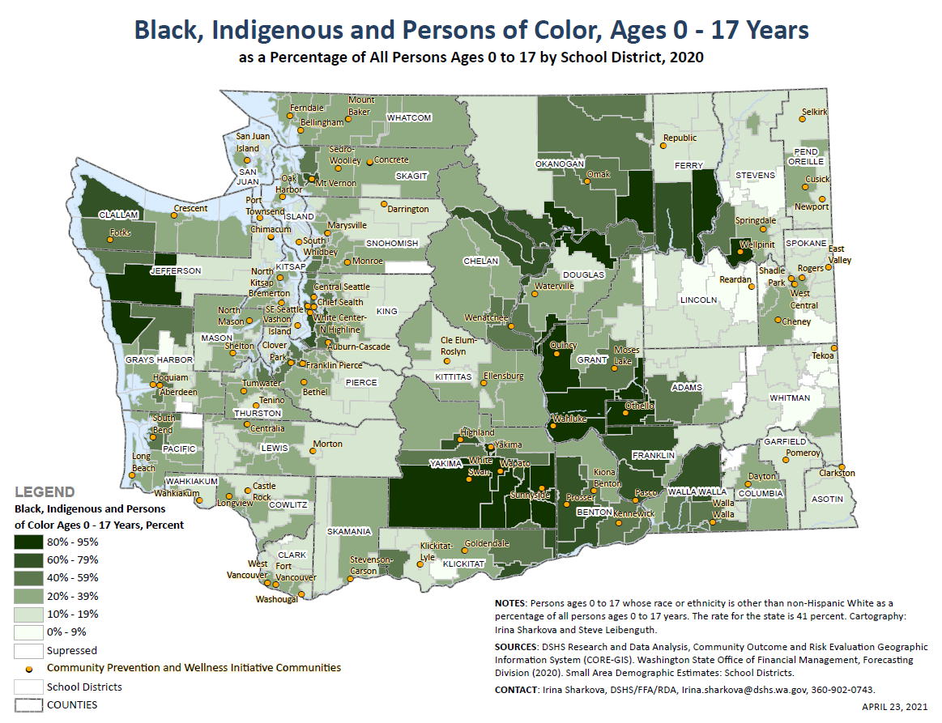

Slide 11

Quantitative Findings
Notes:
This section will take approximately 7 minutes
I know this presentation is about centering community voices – and we will definitely do that. I am briefly going to share the quantitative findings of our health equity report so we have an overview of youth health equity in Washington state

Slide 12
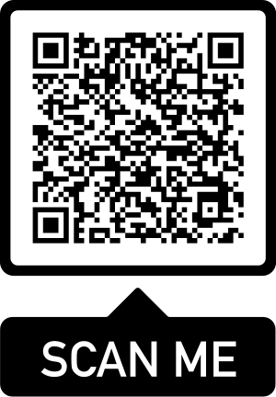
Prevalence Rates of Protective Factors Across Subgroups in Healthy Youth Survey 2021
 |  | American Indian or Alaskan Native | Asian or Asian American | Black or African American | Hispanic or Latino/ Latina | Native Hawaiian or other Pacific Islander | White or Caucasian | Other | Multiracial | Heterosexual | Gay or Lesbian | Bisexual | Questioning | Something else fits better | Male | Female | Transgender | Questioning | Something else fits better
 |  | (n=312) | (n=748) | (n=663) | (n=4,410) | (n=203) | (n=7,058) | (n=496) | (n=2,760) | (n=10,440) | (n=503) | (n=1,877) | (n=727) | (n=750) | (n=7,122) | (n=6,438) | (n=82) | (n=272) | (n=320)
Alcohol | No alcohol use ever | 60.9% | 73.4% | 79.8% | 66.4% | 76.4% | 63.6% | 72.1% | 60.2% | 68.5% | 58.2% | 50.3% | 60.8% | 59.0% | 68.9% | 63.7% | 55.7% | 54.3% | 57.8%
 | No alcohol use in past 30 days | 88.9% | 95.3% | 95.9% | 92.0% | 94.8% | 90.6% | 92.6% | 88.7% | 92.4% | 88.9% | 85.1% | 90.4% | 89.4% | 92.7% | 90.4% | 88.6% | 88.8% | 88.2%
 | No drinking and driving in past 30 days (among students who reported drinking) | 100.0% | 98.0% | 94.2% | 97.5% | 97.8% | 99.0% | 97.4% | 97.1% | 98.1% | 96.3% | 97.9% | 98.4% | 97.4% | 97.9% | 98.2% | 75.0% | 100.0% | 95.5%
 | No simultaneous use of alcohol and cannabis in past 30 days (among students who reported cannabis use) | 75.8% | 93.5% | 87.2% | 91.7% | 97.6% | 85.7% | 83.3% | 86.6% | 89.4% | 83.8% | 79.8% | 90.2% | 90.0% | 89.4% | 86.7% | 93.3% | 91.9% | 88.1%
Tobacco | No cigarette smoking ever | 80.3% | 92.9% | 89.1% | 85.9% | 80.0% | 84.5% | 81.8% | 80.2% | 86.7% | 83.8% | 74.6% | 85.7% | 78.2% | 86.6% | 84.3% | 74.3% | 76.7% | 80.6%
 | No cigarette smoking in past 30 days | 94.2% | 99.6% | 98.8% | 98.9% | 99.4% | 97.7% | 96.9% | 96.7% | 98.6% | 95.9% | 95.6% | 97.9% | 95.2% | 98.3% | 98.3% | 93.7% | 95.2% | 95.1%
 | No e-cigarette use ever | 64.0% | 87.4% | 85.7% | 78.9% | 83.5% | 78.1% | 81.3% | 71.5% | 80.7% | 78.6% | 62.2% | 75.7% | 73.5% | 82.4% | 74.4% | 69.4% | 69.7% | 66.5%
 | No e-cigarette use in past 30 days | 83.6% | 96.7% | 92.8% | 91.9% | 90.8% | 89.7% | 90.8% | 86.9% | 91.9% | 89.5% | 82.1% | 90.5% | 86.9% | 92.7% | 88.9% | 89.6% | 86.5% | 84.9%
Cannabis | No cannabis use ever | 66.2% | 91.5% | 86.4% | 83.7% | 87.4% | 81.4% | 81.4% | 73.7% | 84.0% | 78.3% | 67.5% | 81.3% | 76.1% | 84.2% | 80.0% | 76.3% | 74.4% | 75.7%
 | No cannabis use in past 30 days | 83.9% | 96.7% | 93.9% | 93.9% | 93.1% | 91.3% | 90.8% | 87.7% | 93.1% | 90.0% | 83.3% | 92.1% | 89.2% | 92.9% | 91.2% | 93.7% | 87.3% | 89.1%
Prescription drug misuse | No use of prescription drugs not prescribed to them | 99.3% | 98.5% | 95.5% | 98.3% | 98.8% | 98.3% | 95.5% | 97.7% | 98.5% | 97.3% | 96.1% | 98.8% | 96.5% | 98.5% | 97.9% | 94.1% | 94.0% | 96.5%
Opioid misuse | No painkiller use for non-medical reasons in past 30 days | 100.0% | 99.7% | 98.9% | 99.1% | 97.5% | 99.2% | 99.5% | 98.7% | 99.4% | 99.0% | 98.3% | 99.7% | 96.7% | 99.5% | 98.9% | 93.6% | 98.3% | 96.4%
Other drugs | No use of illegal drugs (excluding alcohol, tobacco, & cannabis) in past 30 days | 95.1% | 98.5% | 97.9% | 98.2% | 96.3% | 98.4% | 96.8% | 98.0% | 98.5% | 98.2% | 96.9% | 99.1% | 97.7% | 98.5% | 98.2% | 91.2% | 99.2% | 97.9%
Peer-individual protective factors | Unfavorable attitudes towards drug use | 54.4% | 67.8% | 61.7% | 62.2% | 67.1% | 58.3% | 61.8% | 56.9% | 62.9% | 49.1% | 45.0% | 55.0% | 52.3% | 64.0% | 57.6% | 38.2% | 43.5% | 48.0%
 | Perception of substance use as risky | 43.8% | 72.1% | 58.0% | 64.0% | 62.5% | 55.7% | 56.6% | 53.0% | 59.6% | 50.2% | 51.1% | 60.9% | 51.8% | 55.8% | 61.3% | 40.6% | 56.9% | 50.0%
 | Unfavorable attitude towards alcohol use | 60.8% | 74.9% | 72.4% | 70.2% | 80.5% | 66.2% | 72.5% | 64.8% | 69.5% | 57.1% | 58.3% | 67.7% | 66.6% | 71.1% | 65.4% | 47.1% | 63.8% | 61.0%
 | Perception of heavy alcohol use as harmful | 73.4% | 84.9% | 77.7% | 75.2% | 73.5% | 75.9% | 69.5% | 74.8% | 74.2% | 79.2% | 79.9% | 85.9% | 76.9% | 72.0% | 78.5% | 67.7% | 83.3% | 75.7%
 | Unfavorable attitude towards smoking cigarettes | 82.3% | 92.3% | 89.0% | 89.6% | 87.8% | 85.3% | 84.2% | 85.8% | 89.2% | 81.7% | 77.8% | 87.3% | 81.1% | 88.7% | 86.9% | 64.7% | 77.4% | 77.4%
 | Unfavorable attitude towards cannabis use | 58.9% | 78.1% | 70.3% | 75.2% | 75.3% | 66.1% | 70.0% | 61.6% | 73.2% | 52.8% | 50.4% | 65.2% | 59.8% | 71.4% | 69.3% | 40.6% | 57.4% | 52.4%
 | Perception of regular cannabis use as harmful | 49.3% | 74.0% | 59.9% | 62.9% | 58.5% | 62.0% | 52.7% | 56.4% | 62.5% | 56.9% | 55.4% | 66.9% | 57.5% | 58.1% | 65.6% | 58.8% | 63.2% | 55.9%
Family protective factors | Has opportunities for prosocial involvement in family | 54.9% | 47.8% | 63.3% | 55.0% | 65.4% | 60.6% | 51.8% | 54.0% | 62.6% | 42.6% | 41.3% | 47.8% | 38.0% | 63.2% | 55.2% | 20.6% | 38.1% | 34.9%
School protective factors | Enjoys school | 19.4% | 27.0% | 22.7% | 24.4% | 28.1% | 27.0% | 24.9% | 24.7% | 27.1% | 19.8% | 21.9% | 23.4% | 18.2% | 28.2% | 24.1% | 13.8% | 20.6% | 19.5%
 | Tries their best in school | 51.4% | 67.8% | 69.0% | 66.3% | 72.9% | 67.4% | 65.5% | 63.4% | 68.0% | 62.7% | 59.6% | 67.3% | 56.4% | 62.4% | 72.7% | 57.1% | 57.9% | 49.3%
 | Has opportunities for prosocial involvement in school | 61.9% | 67.1% | 78.2% | 71.3% | 80.7% | 68.7% | 59.9% | 65.9% | 71.4% | 67.3% | 63.9% | 64.8% | 53.9% | 71.9% | 68.4% | 52.9% | 63.6% | 56.2%
 | Rewarded for prosocial involvement in school | 62.2% | 65.6% | 65.3% | 62.2% | 77.1% | 62.4% | 61.0% | 60.1% | 64.5% | 56.8% | 56.7% | 59.6% | 49.3% | 65.9% | 60.9% | 50.0% | 53.6% | 50.0%
Hope protective factors | Moderate to high hope | 53.9% | 73.0% | 76.4% | 63.3% | 68.1% | 71.3% | 63.0% | 65.0% | 73.4% | 57.0% | 54.1% | 57.2% | 47.0% | 73.8% | 66.2% | 33.8% | 42.0% | 41.8%
 | Adults to turn to for help | 42.7% | 37.4% | 39.4% | 40.0% | 42.4% | 55.7% | 44.8% | 45.4% | 49.5% | 40.9% | 45.2% | 50.0% | 39.3% | 47.0% | 50.9% | 38.0% | 43.3% | 34.8%
Mental health protective factors | Did not plan to attempt suicide in past 12 months | 73.1% | 84.8% | 85.1% | 87.0% | 85.6% | 82.7% | 85.0% | 79.9% | 90.1% | 62.9% | 61.9% | 73.4% | 62.4% | 90.8% | 81.3% | 45.8% | 58.6% | 57.9%
 | Did not have depressive feelings in past 12 months | 53.7% | 59.8% | 63.0% | 60.0% | 64.8% | 60.4% | 60.4% | 52.1% | 67.9% | 32.4% | 31.6% | 43.7% | 33.4% | 73.6% | 50.0% | 16.3% | 26.5% | 26.9%
 | Not bothered by uncontrolled or unstopped worrying over the last 2 weeks | 41.2% | 44.6% | 53.0% | 49.2% | 50.3% | 42.4% | 50.8% | 39.0% | 53.6% | 17.8% | 16.5% | 23.1% | 18.3% | 63.0% | 31.0% | 12.7% | 13.6% | 12.9%
Heat Matrix Legend:
A : Race & Ethnicity
B: Sexual Orientation
C: Gender Identity
1: Substance Use Protective Factors
2: Social and Mental Health Protective Factors
Color gradient is purple (low) to green (high)
A1
B1
C1
A2
B2
C2
Notes:
Overview – We’re presenting data as a heat map to take a broad view to focus on patterns, and we’ll take a closer look at some of these items momentarily. The QR code will take you to the Excel spreadsheet if you would like to take a closer look.
On the top half – these are substance use dimensions including alcohol, tobacco, cannabis, prescription drugs, opioids and other drugs- we see prevalence rates of protective factors are higher – lots of green, not a lot of yellow, and hardly any purple. We see lower prevalence rates of protective factors across the bottom half, which include peer-individual, school, family, and mental health protective factors. We see these patterns are pretty consistent across the three categories of race and ethnicity, sexual orientation, and gender identity which are represented by the 3 columns.

Slide 13
Insight: Mental Health Protective Factors
Across all racial and ethnic groups, most youth did not report a plan for suicide attempt in the past year. Hispanic or Latino/a/x youth reported the least planning, and American Indian or Alaskan Native youth the most.
However, bother from uncontrolled worrying in past two weeks was more common. Black or African American youth reported the least worry, and Multiracial students the most.

Slide 14
Compared to heterosexual peers, gay or lesbian, bisexual, questioning, and those who responded “something else fits better” reported…
Insight: Mental Health Protective Factors
20% less hope
6% less adults to turn to
25% more planned to attempt suicide
34% more depressive feelings
35% less uncontrolled worrying

Slide 15
Insight: Mental Health Protective Factors
Compared to cisgender male and female peers, transgender, questioning, those who responded “something else fits better” reported…
30% less hope
10% less adults to turn to
32% more planned to attempt suicide
39% more depressive feelings
34% less uncontrolled worrying

Slide 16

Summary of Quantitative Findings
Many favorable findings for protective factors across key domains
Particularly favorable for factors related to substance misuse, the primary target of CPWI
Concerns regarding mental health factors for all Washington youth
Social protective factors for gender and sexual minority youth require additional support

Slide 17

Qualitative Findings

Slide 18

Coalition Coordinator Interviews
16 Zoom interviews were conducted Summer 2022
Questions:
Local context for health equity promotion
Facilitating factors and barriers of health equity promotion
How the communities can be better supported by DBHR
Interview data were analyzed using team-based rapid thematic analysis
Notes:
The purpose was to find out what facilitates or hinders health equity work in the CPWI communities and help establish a starting point for more granular equity evaluations in the future
We adapted team-based qualitative analysis to leverage team expertise and conduct focused coding without compromising rigor and used Dedoose software for qualitative coding

Slide 19
Key Themes from Interviews
Local Context pertains to the characteristics of coordinators and of community
Facilitators are the factors helping to promote health equity
Barriers for the health equity work
Needs of the coalitions
Notes:
Four overarching themes emerged from the analysis.

Slide 20
Key Theme: Local Context
Diversity in coordinators’ knowledge and experience
Coordinators’ acknowledgement of discomfort or lack of expertise
Coordinators’ positionality hinders or helps equity work
Use of flexible communication styles, meeting structures, and coalition processes to meet coalition and community needs
Room for improvement in membership diversity and composition
Varied meaning of diversity, equity, and inclusion across communities
Notes:
Context pertains to the descriptive characteristics of the coordinators as well as communities such as, age composition of the communities, poverty levels, urban vs rural communities, race/ethnicity etc.
These are the major sub-themes of the local context.
Diversity in coordinators knowledge and experience and their acknowledgement of lack of expertise. Coordinators positionality meaning their individual's standpoint or perspectives shaped based on their identity, and personal experiences. And some coordinators explicitly stated being aware of their race/ethnicity and how it might hinder work or help the work
Using different communication means and styles to connect with the members and stakeholders
Fewer coordinators thought membership reflected the community

Slide 21
Context: Coordinator's Positionality
“Because I am [non-White], you know my family was a migrant family [and] low income, I’m a first-generation college student—like I have had the experience of being on the other side of you know, the ‘target population.’ It’s always present for me that if I don’t make space for people that look like me, and have had experiences like me, those spaces will not exist.”
*Bold highlights added to the quote for emphasis
Notes:
I am not going to read all the quote but the bold highlights emphasize the gist of the quote....

Slide 22
Key Theme: Facilitators
Adapting program materials, timing and processes
Adapting to address problems and increase efficiency
Coordinators’ knowledge, experience, and skills
Inclusivity and openness in membership
Community buy-in, partnerships, and relationships
Framing of health equity conversation to improve engagement
Notes:
Facilitators [facilitating factors]
Partnerships: engaging people, continued conversations with community members and partners about how to address local needs is helpful. There are typical partnerships mentioned like with school districts and first responders, but some partnerships were with other healthcare organizations, recreation centers, and so on.

Slide 23
Facilitators: Community buy-in, partnerships, relationships, and networks
“You've got to build trust and build relationships. Because if you don't do that then the information you're bringing in could be rejected and … they close the door. You want to be able to have opportunity to access different groups and different leaders and just different influential people so that you can continue to grow those conversations.”
*Bold highlights added to the quote for emphasis
Notes:
The quote describes how you need to build trust and relationships and create opportunities to access different groups/ leaders to grow the conversation around equity.

Slide 24
Key Theme: Barriers
Resource constraints (e.g., funding, materials, adequate technology, services)
Language or cultural barriers
Difficulties with engagement in coalition work
Coordinators’ unfamiliarity with CPWI and coordinator burnout
Lower community capacity and readiness
Notes:
Coordinators being new to the coalition work or to the community were described as a barrier in terms of limited or lack of familiarity with the community.
The coordinator turnover alongside limited time for handover and training leave the new coordinators to struggle and get overwhelmed with planning, implementing, or community outreach as they start their job as a CPWI coordinator.
Regarding the resource constraints this pertain to the challenges the coalitions experience in terms of lack of programs, program materials, campaigns or community surveys adapted and translated to meet the linguistic, cultural, educational (literacy) needs of the diverse population groups

Slide 25
Barriers: Resource constraints
“There are not many options when it comes to service providers in the area and those service providers in the area are limited when it comes to whether they will see someone on Medicaid or even what type of Medicaid they're on. So many people have to travel 30 miles to have more options for services.”
*Bold highlights added to the quote for emphasis
Notes:
This quote describes the structural barriers and because of how lack of options and service providers people have to travel long distances to access services

Slide 26
Key Theme: Needs
Material support
Flexibility in requirements
Spending flexibility and unsiloed funding
Accessible training and capacity building
Notes:
Funding-related challenge that was highlighted by the coordinators is the siloed and separate funding streams which fail to address whole-person help and interventions. In addition, budgets do not necessarily include funding for equity with no requirements for health equity deliverables, which often gets overlooked.
Material support is related to the lack of culturally relevant programs.
the needs for different trainings including a) systemic and cultural racism; b) LGBTQ+ support; c) cultural competency; and also in rural communities, d) health equity, diversity, and inclusion trainings; e) trainings to address community stigma against people living in poverty or people with substance use disorders and misuse; f) outreach and community engagement trainings, and in general, DBHR support to integrate health equity into strategic planning and implementation

Slide 27
Needs: Flexibility in requirements
“I would just say engaging with different communities a little differently would be nice. It seems very top-down and it's very forced. And anything being forced just makes people more resistant.... And there are real disparities. What I mean is that prescribed top-down, 'here's a solution you must follow' is not going to work.”
*Bold highlights added to the quote for emphasis
Notes:
To summarize, analysis of interviews indicates that the context of health equity work varies across communities and the context drives the different approaches to achieving health equity. However, community support, strong partnerships, and trusting relationships with community members were identified as facilitators of health equity work. Our analysis indicates that CPWI communities and coalitions are resilient and creative in addressing resource, capacity, and social barriers.

Slide 28
What, So What, Now What (W3) Together, Look Back on Progress and Decide What Adjustments Are Needed
Liberating Structures: http://www.liberatingstructures.com
Notes:
So, now let’s do our group activity. It’s called, What, So What, Now What

Slide 29
What, So What, Now What (W3)
What: What did you notice, what stands out to you about the CPWI health equity evaluation? Stay at the level of direct observation and fact as best as you can.
So What: So, what meaning can you make out of these observations? So, what conclusions can you draw from your observations?
Now What: Identify next steps and actions you can take to use this information in your prevention work.
Notes:
Please get into a group of 3 to 4 for this activity. First discuss the what – what did you notice, what stands out to you about the CPWI health equity evaluation? Please Stay at the level of direct observation and fact as best as you can.
Then discus the so what? So, what meaning can you make out of these observations? So, what conclusions can you draw from your observations?
Then discuss the now what: Identify next steps and actions you can take to use this information in your prevention work.
We will spend about 10 minutes on the small group discussion, and it would be good to have some volunteer report out to the larger group what they discussed.
After 10 minutes.
Would a couple of people like to share with the larger group some highlights from your discussion?
Thank you everyone for being here. Please feel free to contact us if you have any questions.

Slide 30
Thank you!
Gitanjali Shrestha
gshrestha@wsu.edu
Konul Karimova
Konul.Karimova@wsu.edu
Heather Terral
Heather.terral@wsu.edu

Slide 31
Across racial and ethnic groups, prevalence of substance use protective factors were high.
Although rates for other protective factor domains were lower, they remained over 40%.
Notes:
On this slide we have a radial chart and each of the six angles represents a domain of protective factors; the outermost line represents 100% and the innermost line is 0%. The color lines represent racial and ethnic groups, and the extent to which their line approaches the outermost line indicates a higher prevalence of protective factors. When we look at the top point, all substances protective factors, no group averaged 100% across all of the subdomains (such as alcohol, tobacco, cannabis) and no group had below 70%. The clustering of all of the lines together tells us that the differences between the groups aren’t large wider gaps between lines would indicate wider disparities.
We see that Asian or Asian American youth reported slightly more peer-individual protective factors than their peers, and White youth reported slightly more hope. Native Hawaii’an or other Pacific Islander youth reported the highest prevalence of school protective factors and mental health protective factors.

Slide 32
Across sexual orientations, groups, prevalence of substance use protective factors were high.
Sexual minority youth reported less family, hope, school, and mental health protective factors.
Notes:
Compared to comparisons between racial and ethnic groups, we see much wider gaps in protective factors by sexual orientation. Students identifying as “something else fits better” reported the lowest number of school, hope, and family protective factors. “Questioning” students tended to reported higher rates of protective factors than their gay or lesbian and bisexual peers.

Slide 33
Across gender identities, prevalence of substance use protective factors were high.
Yet, transgender youth reported fewer protective factors across all domains compared to their peers.

Slide 34
A Closer Look:
School Protective Factors
Across all racial and ethnic groups, a large gap between reported enjoyment of school and trying their best is apparent.
This gap was largest for Black or African American students and smallest for American Indian or Alaskan Native youth.
Notes:
These data were collected during 2021 and likely reflect the challenges of schooling during the emergency stage of the ongoing covid-19 pandemic. Despite such large numbers of students trying their best, less than a third of any group reported enjoying school. It will be interested to see how this compares with future survey data.

Slide 35
A Closer Look:
School Protective Factors
As with racial and ethnic groups, a large gap between reported enjoyment of school and trying their best was detected across sexual orientations.
The gap was largest for Questioning youth and smallest for Bisexual youth
Notes:
The same pattern of results is present when looking at these two school protective factors.

Slide 36
A Closer Look:
School Protective Factors
As with other subgroup comparisons, a large gap between reported enjoyment of school and trying their best was detected across sexual gender identities.
The gap was largest for Female youth and smallest for youth who chose “something else fits better” for this category.

