Slide 1


The Pandemic Effect on Alcohol Compliance Checks, DUI Crashes, and Underage Drinking: The South Carolina Experience
Michelle M. Nienhius, MPH, NPN (SC), DAODAS
Notes:
Custom DAODAS color codes is : Red-0
Green-131
Blue-139

Slide 2
Presentation Objectives
Comprehend the results of the process and outcome evaluations for the South Carolina Alcohol Enforcement Teams (SCAET) for state fiscal years 2006 (July 1, 2006) through 2023 (June 30, 2023).
Know that the alcohol non-compliance rate (buy rate) increased during the COVID-19 lockdown and the subsequent months when law enforcement temporarily paused alcohol compliance checks.
Learn about developing and maintaining a long-term, productive relationship between local and state prevention and law enforcement agencies.
Ascertain the process required to build a statewide underage drinking effort with emphasis at the local level.
Understand possible reasons for reduced enforcement and consequential increased buy rate during and after the COVID pandemic.
Learn about environmental strategies meant to reduce underage consumption of alcohol.
Understand that consistent alcohol compliance checks are needed to reduce underage drinking traffic crashes.
Notes:
Section Header Slide

Slide 3
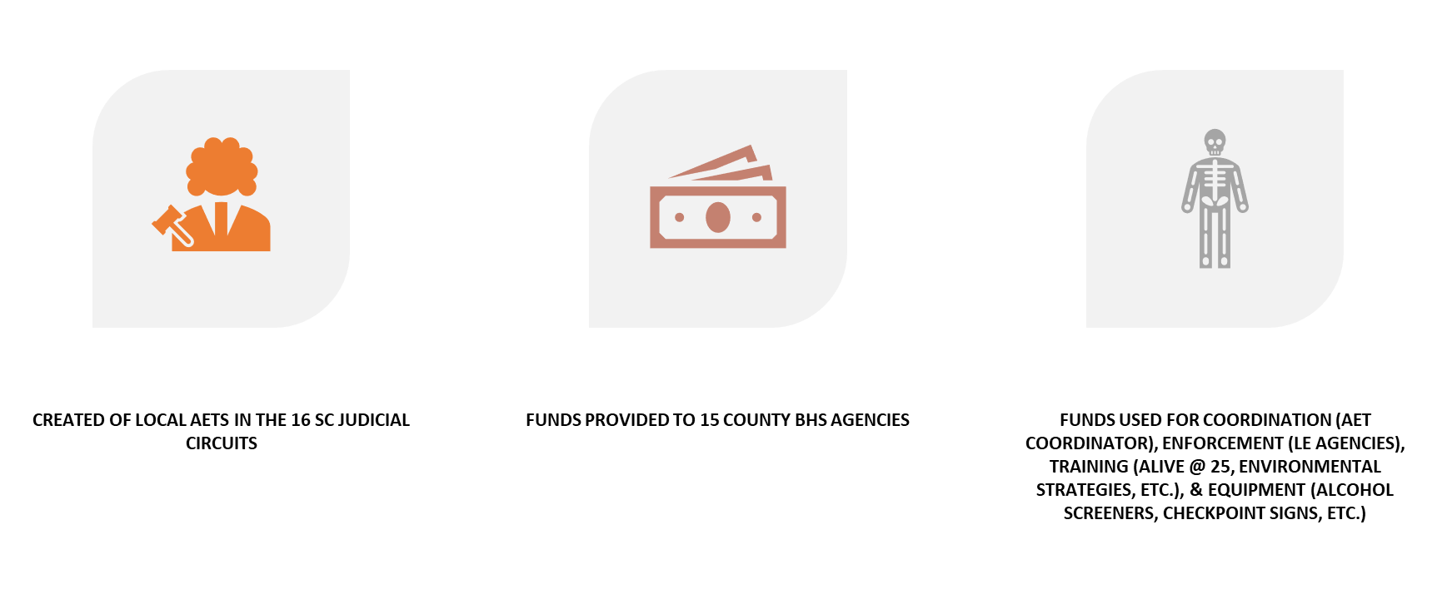
Passage of the Prevention of Underage Drinking and Access to Alcohol Act of 2007
Notes:
Section Header Slide

Slide 4
Funding Resources for Environmental Strategies in
South Carolina
The Alcohol Enforcement Team efforts have been funded through a combination of federal (SUPTR BG/EUDL BG and EUDL Discretionary grants), state and local funds.
Funding levels have varied from year to year and county to county. Some counties have received additional federal grants to increase the funding available for AET efforts (NHTSA, Drug Free Communities, SAMHSA Discretionary grants).
The highest level provided by the state was $1,600,000 (2008/2009). This level provided $98,000/circuit.
Current level of funding, $640,000 provided by the state (through federal grants) has remained steady since 2010 (with the exception of one year when it declined to $560,000). This level of funding has provided between $35,000-$50,000/circuit-based on population.
Currently the funds provided by the state are used to support coordination, training and incentives (supplies/materials) for law enforcement partners. Funds provided by the state cannot be used to support officer overtime.

Slide 5
Allowable and Unallowable Costs for Lead Agency for Circuit
Allowable
Agency staff/contract person salary to include associated cost based on agency's cost allocation plan (fixed charges, office supplies, contractual services, administrative cost, etc.)
Contractual agreements with LE agencies for achieving milestones
Incentives for youth volunteers not to exceed $30.00 in non-cash,
Postage for info dissemination to merchants, parents, local government officials, other LE agencies
Media campaigns (newsletters, newspaper, radio/TV PSA) and printed materials (flyers, brochures, billboards) clearly prevention of underage alcohol use related.
Unallowable
Contractual agreements with LE agencies/agents for time/overtime
Supplies/equipment/materials/apparel even AET-related is not allowable
Media campaigns (newsletters, newspaper, radio/TV PSA) and printed materials (flyers, brochures, billboards) for general prevention or marketing of the agency

Slide 6
Allowable and Unallowable Costs for Law Enforcement Agencies
Allowable
Fee/charge to circuit lead agency for achieving and documenting milestones. These funds can then be used as follow:
Advanced training for officers on implementing evidence-based environmental strategies to reduce underage drinking
Media materials related to the prevention of underage alcohol use (e.g. billboards, radio and TV ads, flyers, buttons, etc.)
Provide trainings/conferences related to implementing best practice environmental strategies aimed at reducing underage drinking
Officers time for prevention activities that are not enforcement:
Working with the media, providing public presentations/ information dissemination, train other officers on how to conduct effective environmental strategy enforcement operations to reduce underage drinking, etc.), teaching educational programs, participating in community-based process activities and alternative events.
Training of LE personnel:
Monthly workshops, quarterly training, national trainings-Northwest Alcohol Conference, Life Savers, etc., SC Highway Safety Conference, DAODAS/SCAPPA trainings
Speaker fees
Room rental
Materials/handouts
Alternative event activities related to underage drinking prevention:
(e.g. after prom, community events, fairs, etc.)
Unallowable:
Time/overtime payments for LE agents to perform law enforcement activities
Supplies/equipment/materials/apparel even AET-related is not allowable

Slide 7
Alcohol Enforcement Teams (AETs)
Coupled with an active public education and prevention strategy, AETs are intended to implement evidence-based environmental strategies to reduce underage alcohol use and its harmful consequences.
The AET model, which includes community coalition maintenance and development, merchant education, and law enforcement partnership, specifies a multi- or single-jurisdictional alcohol law enforcement approach (depending on the needs and participation of law enforcement within the target area) in a community to:
  Reduce youth access to alcohol utilizing various strategies (social and retail access)
  Measure, track, and improve merchant compliance with alcohol laws
  Provide research-based merchant education
  Build community support for enforcement of underage drinking laws through media advocacy and community coalition maintenance and development
  Develop local law enforcement support for underage drinking prevention and enforcement efforts

Slide 8
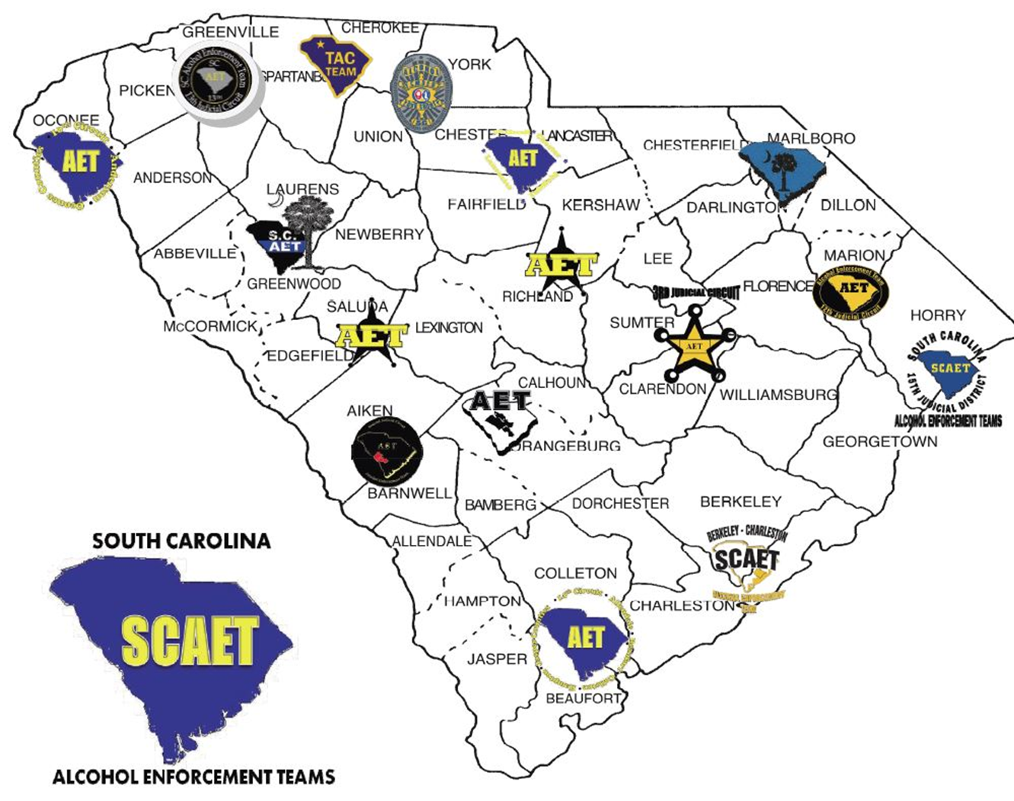
Each Circuit hired a Coordinator
Began extending community relationships and building new ones toward building the teams
All teams formed by October 2007
Notes:
Content Slide With No Bottom Border

Slide 9
South Carolina Initial Steps Toward Collaboration
State AET Liaison hired
State meeting involving coordinators
Regional AET Training for LEOs & partners
Lead Agency in Circuit Identified
Began Bi-monthly State Meetings
Statewide reporting system established
15 AET Coordinators hired for 16 circuits
Notes:
Section Header Slide

Slide 10
Infusion of Cultural Competency in AET model….
What do we mean?
SAMHSA defines cultural competence as "the ability of an individual or organization to interact effectively with members of diverse population groups
While awareness of cultural aspects of population groups is tantamount to ensure ALL population groups are reached….
Understanding organizational culture of coalition members is important to successful collaboration on community problems.
Schein (2010) defines organizational culture as “the basic tacit assumptions about how the world is and ought to be that a group of people share and that determines their perceptions, thoughts, feelings, and, their overt behavior”.
An understanding begins by spending time with coalition members (i.e. social events, coalition meetings, training, community events)
Schein, E. H. (2010). Organizational culture and leadership (4th ed.). San Francisco: Jossey-Bass.
Notes:
Section Header Slide

Slide 11


What did DAODAS Provide?
Short training at Initial state meetings for Prevention staff in South Carolina to acclimate them to law enforcement profession & culture
Law Enforcement 101
Notes:
Section Header Slide

Slide 12

Collaborating with Law Enforcement
Some agencies may embrace the underage drinking enforcement concept & and provide officers at no charge
Paying overtime may be possible; other methods of “payment” may work
Recognition, training, & equipment…other incentives or rewards

Slide 13
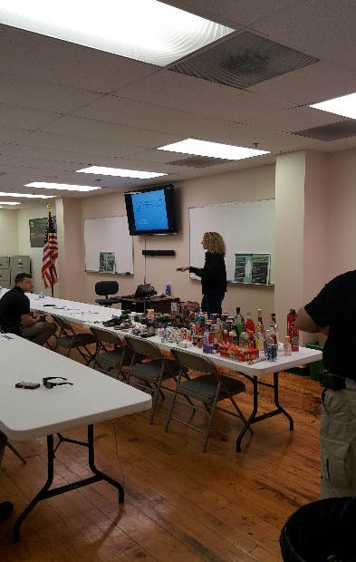
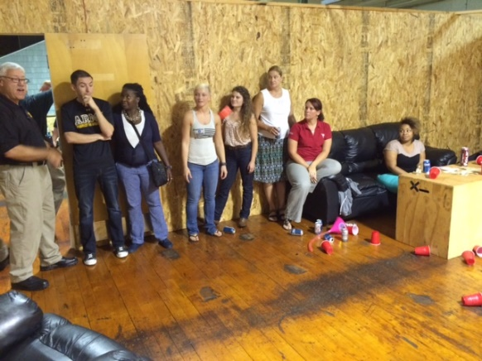
Free regional training for law enforcement, prevention specialists, and other community stakeholders-built CAPACITY for underage drinking enforcement and education in the community.
SCAET Class Title | SCCJA Hrs. awarded
Fake and Fraudulent ID Training | 5.0
AET: SC Underage Drinking Laws and Alcohol Products (AET 101) | 3.0
Alcohol Enforcement Team Activities Training | 4.0
Alcohol Enforcement Team Training – Mock Party Dispersal | 4.5
Special Alcohol Events Management Law Enforcement Training | 4.0
AET: Keys to Implementing Effective Environmental Strategies in Local Communities | 12.25, 6.25
Impaired Driving Public Safety Checkpoint Instruction (DVD) | 0.5
PAS Systems Training | 2.0
Source Investigation | 4.0
South Carolina Youth Tobacco Education & Enforcement Training | 2.5
Public Safety Checkpoints: A tool to combat impaired driving in local communities | 4.0
The training also helped develop and extend community relationships among stakeholders.
Notes:
Section Header Slide

Slide 14
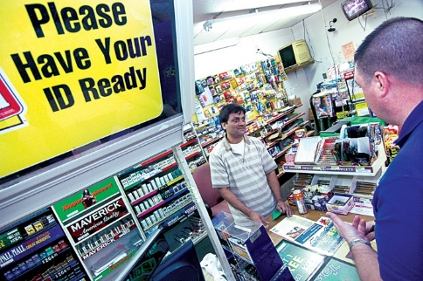

Initial Environmental Strategy
DAODAS funded several county-level AETs previously
Alcohol Compliance Checks
Circuit AETs had capacity
Many law enforcement agencies were experienced in compliance checks
County AOD Agency Prevention staff conducted merchant education (responsible beverage service) training
State-level enforcement reporting was in place

Slide 15
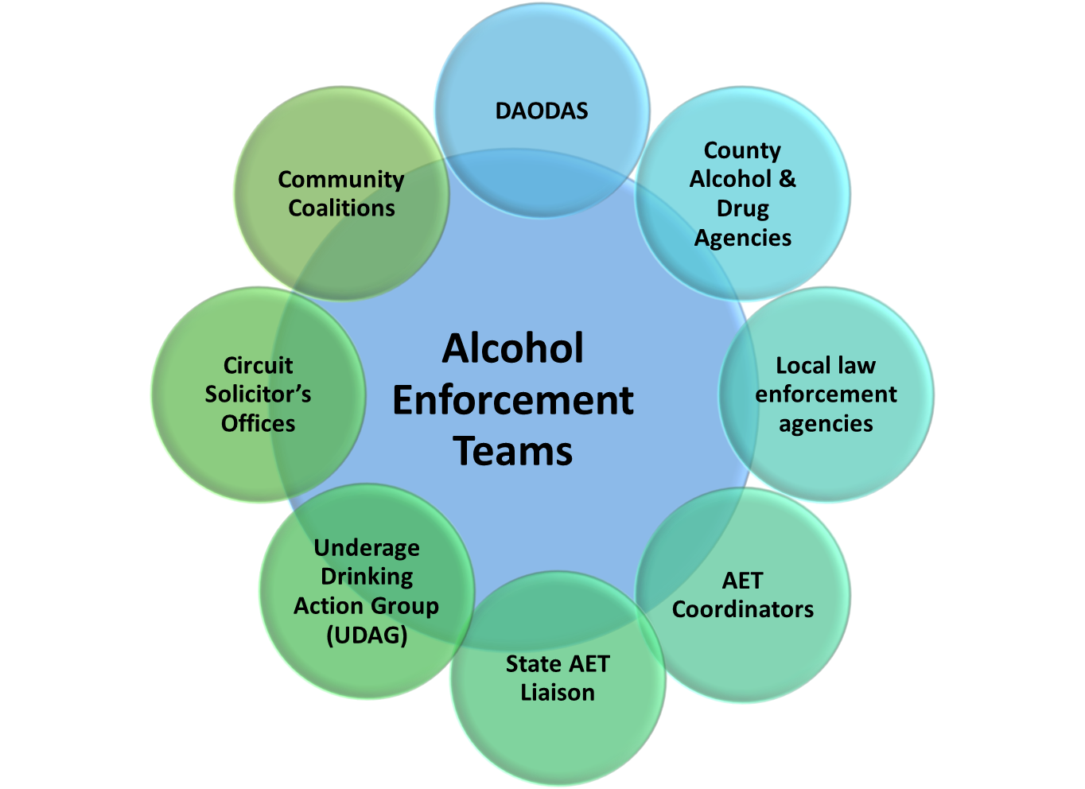
AET Partnerships and Structure

Slide 16
Evaluation of statewide AET conducted 2017-2018;
Article published Jan. 2021
George, M. D., Holder, R., Shamblen, S., Nienhius, M. M., & Holder, H. D. (2021). Alcohol Compliance Checks and Underage Alcohol-Involved Crashes: Evaluation of a Statewide Enforcement Program in South Carolina from 2006 to 2016. Alcoholism: Clinical and Experimental Research, n/a(n/a). https://doi.org/https://doi.org/10.1111/acer.14507

Slide 17
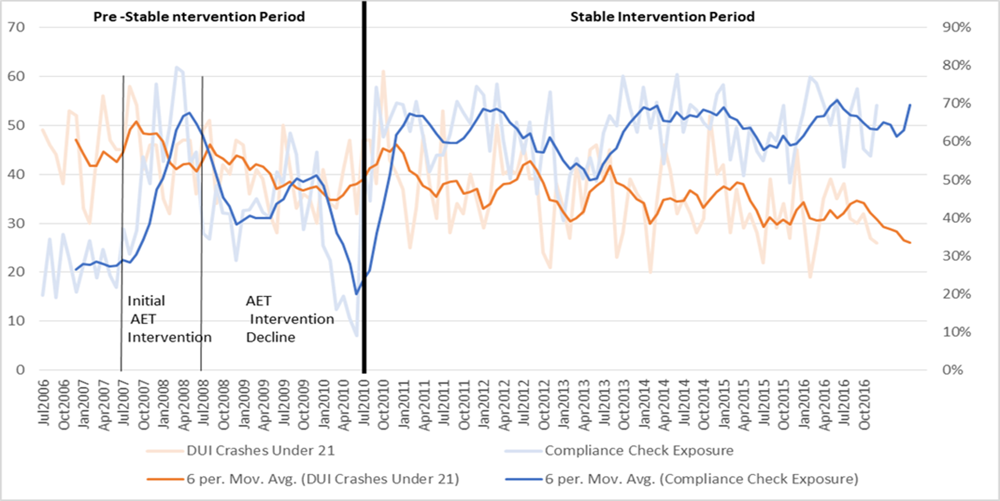
Index of Exposure to Compliance Checks, Possible Intervention Periods, and Drinking and Driving Crashes for Drivers
under 21-year-old

Slide 18
Outcomes for SC in Reducing
Underage Drinking prior to Mar. 2020
Survey Item (YRBS) | 2005 | 2019 | % decrease
high school students reported ever drinking alcohol | 71.1% | 49.6% | -30.2%
reported drinking alcohol before age 13 | 25.6% | 12.3% | -52.0%
reported drinking alcohol in past 30 days | 43.2% | 23.1% | -46.5%
reported binge drinking (5 or more drinks in 2-hour time period) in past 30 days | 23.6% | 9.2% | -61.0%

Slide 20
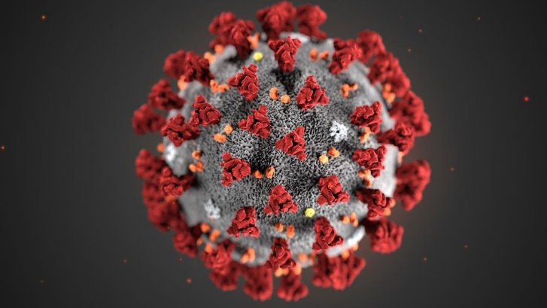
Impact of COVID-19 in South Carolina relating to Environmental Prevention
March 7, 2020: First COVID 19 cases reported in Charleston & Kershaw counties
March 15, 2020: South Carolina Governor Henry McMaster declared state of emergency and closed all but essential businesses. AETs discontinued enforcement operations.

Slide 21
Impact of COVID-19 in South Carolina relating to Environmental Prevention
In mid-year FY 2017, we began implementing Online Reporting, so it was July 2017 (FY ‘18) before it was fully implemented. Until Apr. ’20, average monthly checks = 508, Apr. & May ’20 (yellow) with compliance checks & other environmental strategies returning starting Jun.’20. The buy rate remained steady until 2021. It has dropped each year since 2021. New reporting online reporting system implemented Jul 2022.

Slide 22
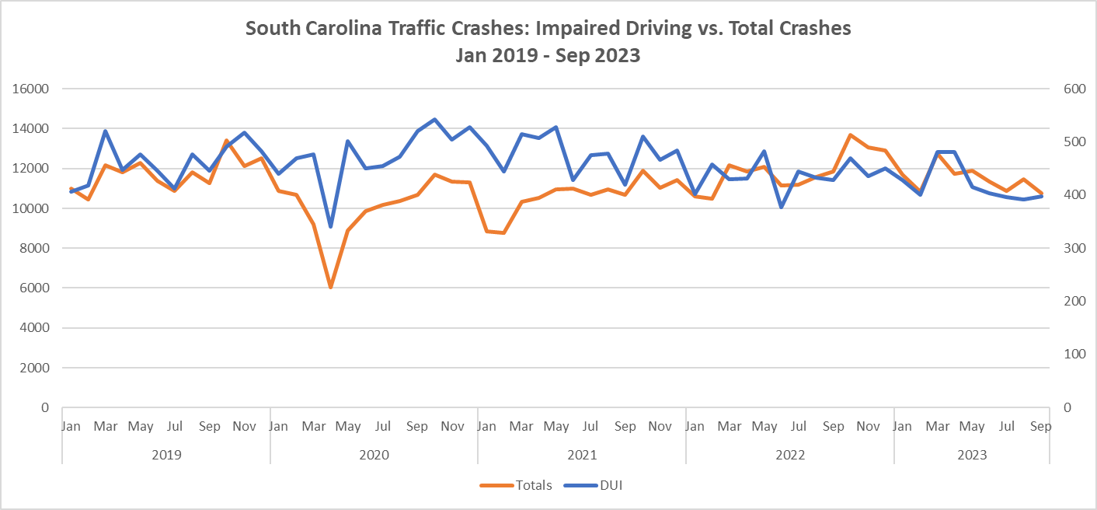




2019 to Mar. 2020 avg.
461 DUI crashes monthly
2019 to Mar. 2020 avg.
10,981 overall crashes monthly
May 2020 - Mar. 2021 avg.
476 DUI crashes monthly
May 2020 – Mar. 2021 avg.
9,479 overall crashes monthly
Apr. 2021 - Dec. 2023 avg.
444 DUI crashes monthly
Apr. 2021 – Dec. 2023 avg.
11,507 overall crashes monthly
Impaired Driving crashes followed Total crashes more closely and in Mar 2023, dropped below

Slide 23
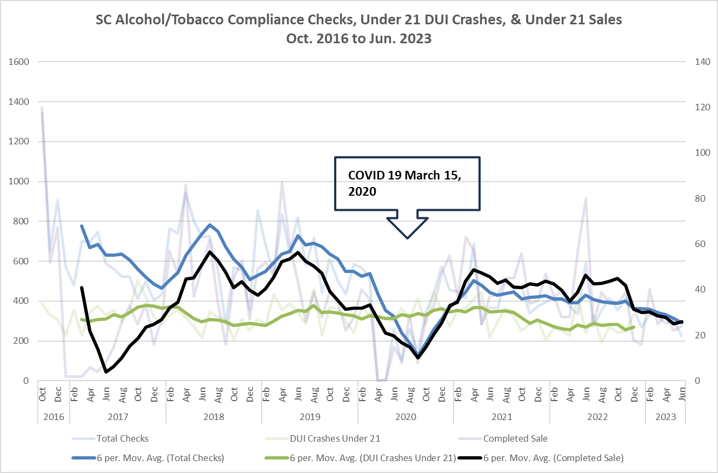
Under-21 impaired drivers remained somewhat constant, with a slight increase during and immediately after the pandemic when no or a small number of compliance checks occurred. The sales completed rate increased when compliance checks were restarted after the pandemic.

Slide 24
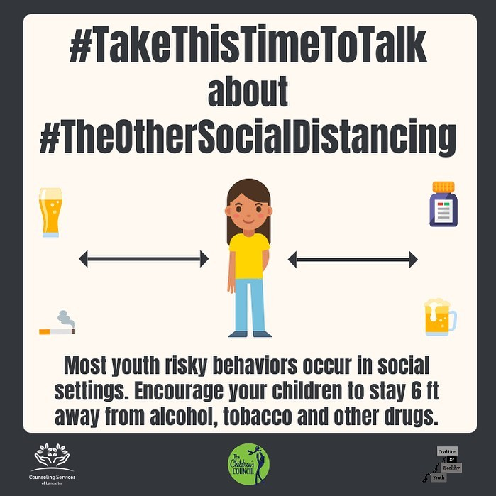
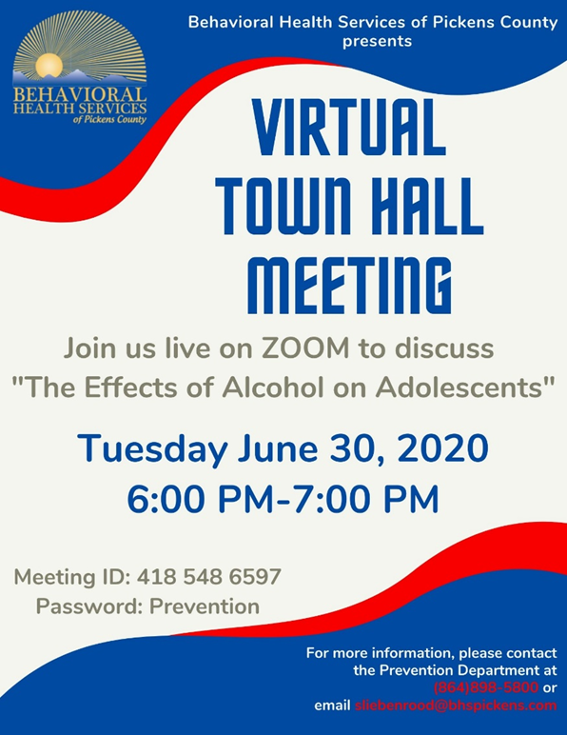
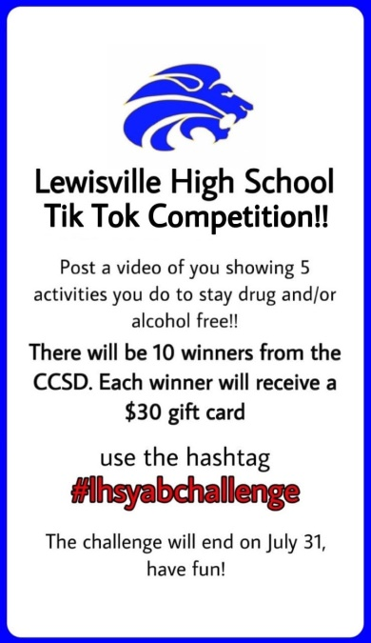
Adapting Primary Prevention Services During COVID-19
Temporarily, prevention professionals were at loss to deliver prevention programs because public meetings were not allowed. Prevention professionals adapted to stay at home orders & implemented virtual meetings and virtual community events
Information indicate that the strong partner relationships built and maintained prior to pandemic sustained community efforts through the pandemic
For instance, in many counties, partner organizations expressed creative ideas to still implement AET activities during COVID-19 through social media and Facebook Live

Slide 25
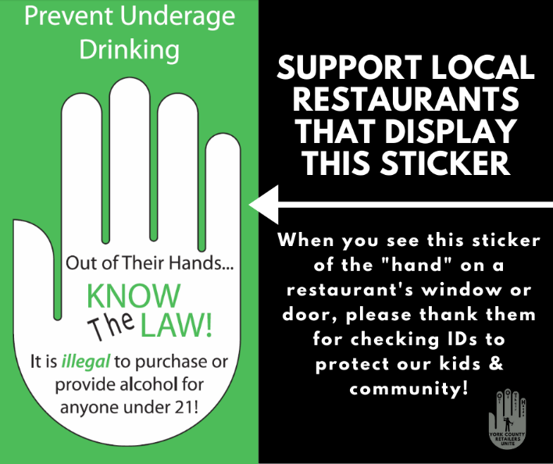
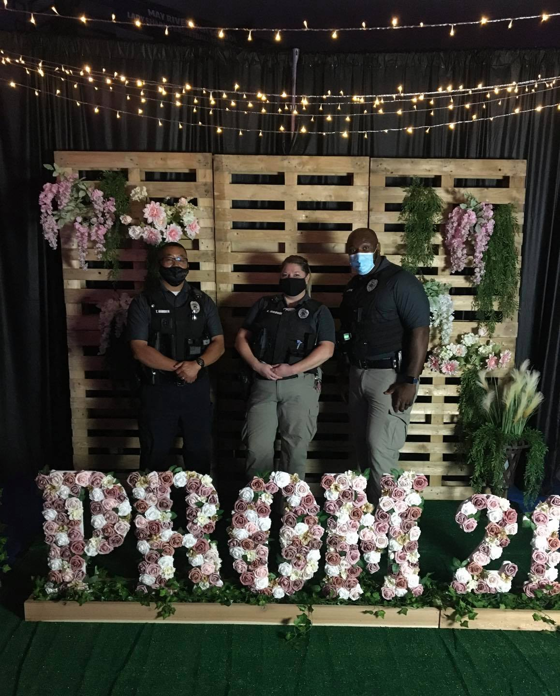
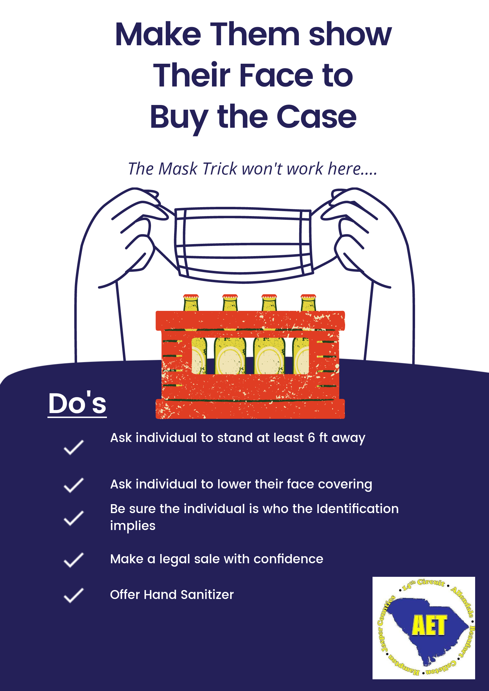
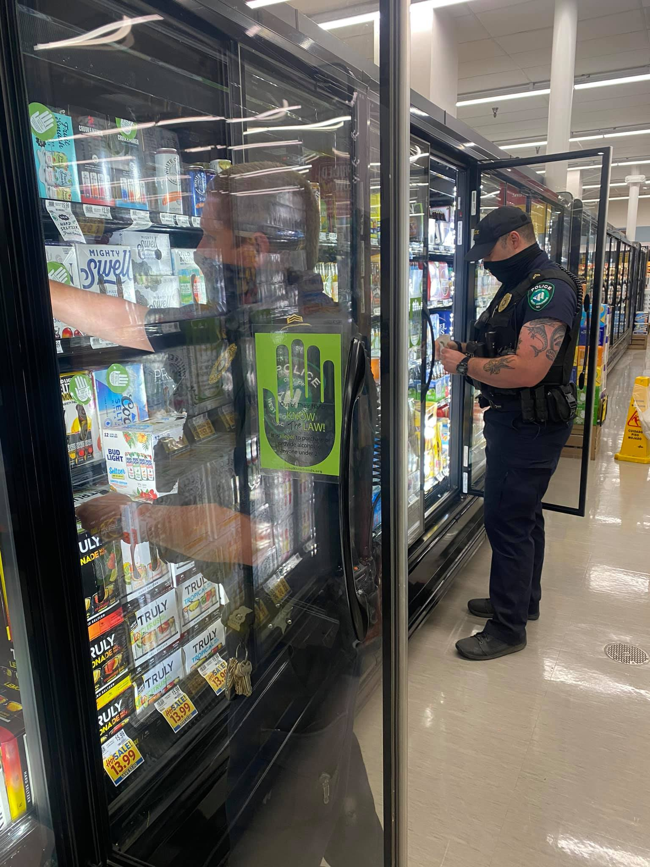
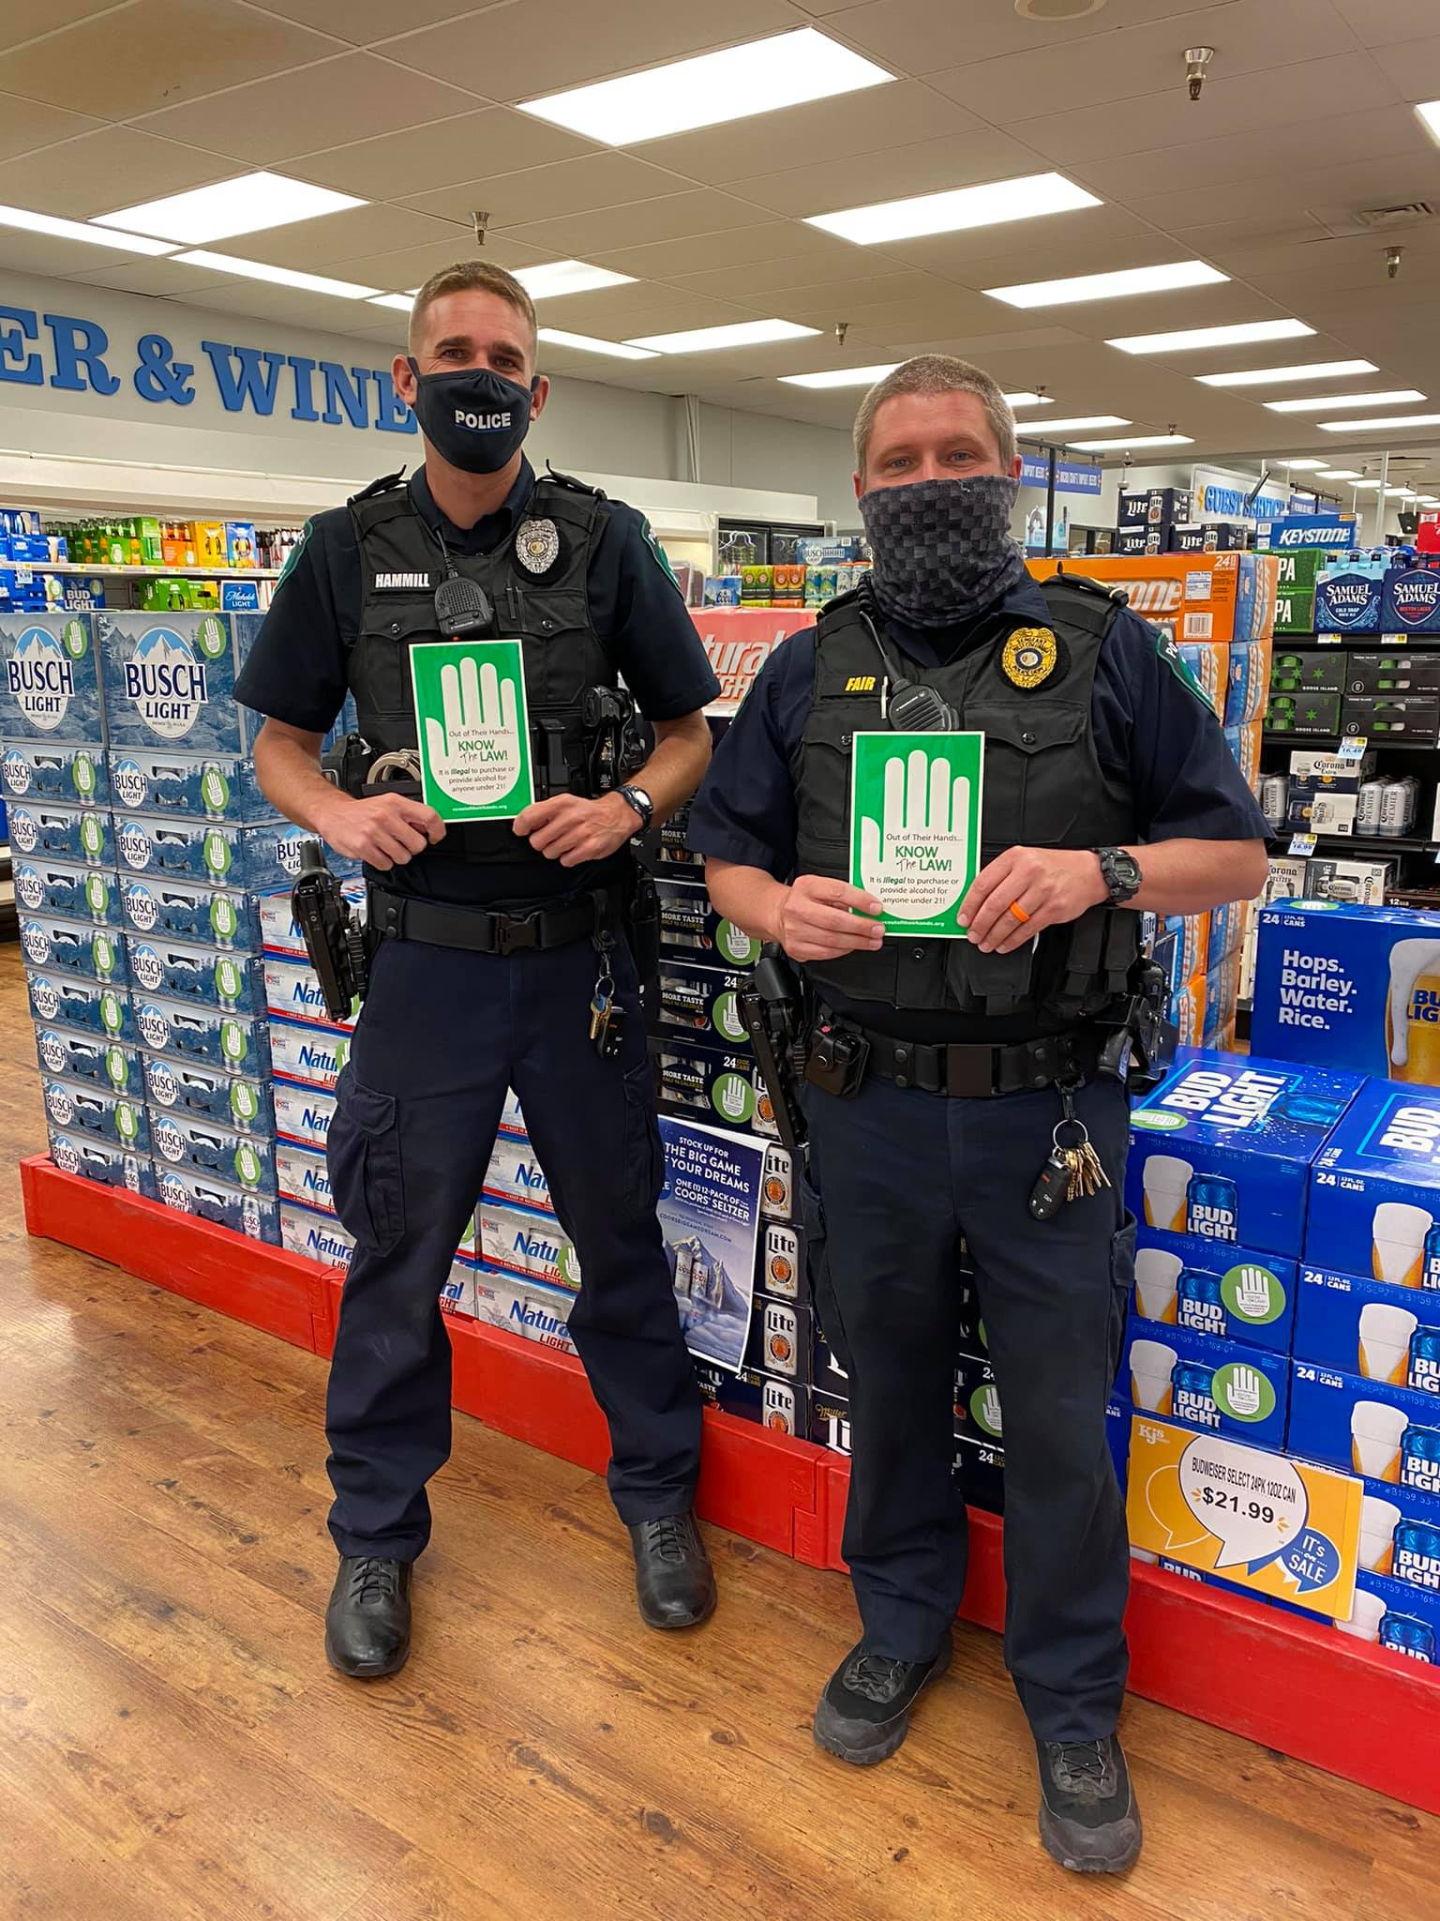

Slide 26
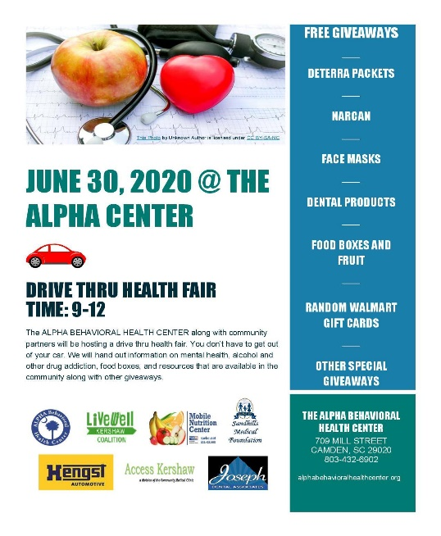
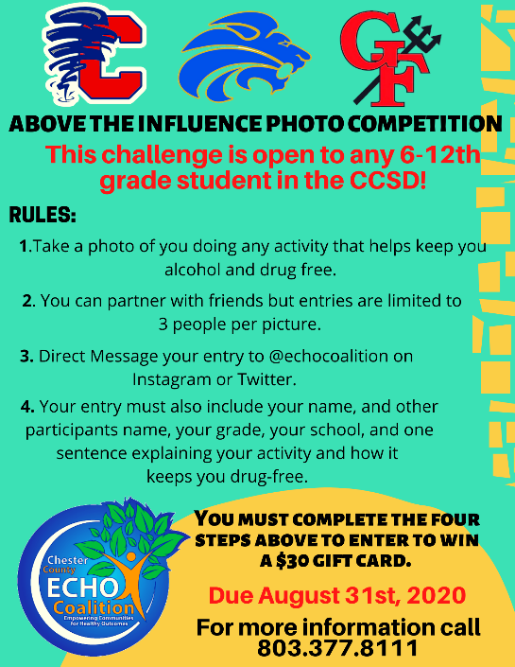

Adapting Primary Prevention Services During COVID-19
MADD recorded “Power of Parents” and “Power of Youth” presentations that could be shared with community groups
Local agencies increased use of social media, partnered with food banks/school lunch programs to disseminate information and held drive-thru health fairs
Local agencies hosted drive-thru recognition/celebration events

Slide 27


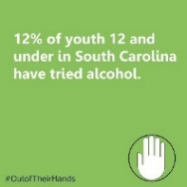
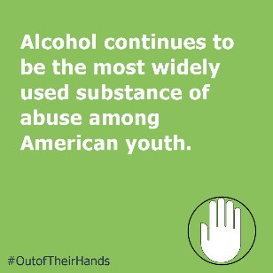

Adapting Primary Prevention Services During COVID-19
State supported the locals by hosting “Open Calls”, weekly updates and hosting virtual meetings/trainings events
State also provided guidance to teach PREP virtually,COVID-19 guidelines for compliance checks KAHOOT game for middle and highs school students on alcohol facts/myths and social media calendar for “Out of Their Hands”
https://www.daodas.sc.gov/prevention/law-enforcement/underage-drinking/hands-social-media-graphics/

Slide 28
Teaching PREP Via Online Platform
While face-to-face delivery of the program is the preferred method, it is understandable that during the public health crisis, this program will need to be delivered via technology.
Fidelity of the program and delivery of all material continues to be of utmost importance. The virtual platform that you choose should allow you to:
  Utilize all program materials- power point, handouts and videos
  Have a discussion with participants and answer questions
The agency needs to mail the participant booklet ahead of the class
Use a platform that allows you to see your participants is best-this will allow you to interact with (see when they have a question, looking confused, etc.).
The certification test was set-up on an online platform (Easytestmaker.com). The participants receive a link and code to access the test. The participant has 30 minutes to complete the test. At the conclusion of the course, the agency is asked to send the following information to DAODAS for the scores and test results to be returned via email: first and last name of the participant and the date of the training.

Slide 29
Alcohol and Tobacco Compliance Checks: COVID-19 Safety Procedures
Due to COVID-19, we would like to include these additional safety procedures for you to adhere to while conducting alcohol and tobacco compliance checks. Safety is the priority! If the operation cannot be conducted safely, please do not proceed. Ultimately, your agency, adult volunteers, law enforcement officers, and youth need to feel confident that they can remain safe during the operations.
While out in public, the Centers for Disease Control and Prevention recommend the following:
Wear a mask (please provide masks for all your volunteers).
Stay at least 6 feet (about 2 arm’s lengths) from other people.
Do not gather in groups.
Limit your contact with frequently touched surfaces, such as countertops, door handles, etc.
Avoid sharing pens or other items.
Use a foot, shoulder, elbow, hip, or forearm instead of hands when opening doors at stores, if possible.

Slide 30
Alcohol and Tobacco Compliance Checks: COVID-19 Safety Procedures
Avoid touching your eyes, nose, and mouth.
Proper hand hygiene is an important infection-control measure. Wash your hands regularly with soap and water for at least 20 seconds whenever available or use an alcohol-based hand sanitizer containing at least 60% alcohol. (Provide hand sanitizer for your volunteers.)
Carry cleaning and disinfectant spray or disposable wipes and a trash bag in your vehicle.
Clean and disinfect commonly touched surfaces in your vehicle at the beginning and end of conducting the study, particularly if the vehicle is also used by other drivers. Clean surfaces that are visibly dirty with detergent or soap and water prior to disinfection. Frequently touched surfaces include the steering wheel, gearshift, signaling levers, door handles, and seatbelt buckles.
In order to follow social distancing guidelines, you might want to consider allowing youth to drive themselves to the locations, with adult volunteers/law enforcement following in separate vehicles. You might also want to consider attempting to recruit parents as the adult chaperones, which would eliminate the need for people from too many different households to be involved with the check. The parent and youth could ride together and then not be in direct contact with the law enforcement officers. (Regardless of who is driving, please provide a mask and hand sanitizer for the youth to use each time they enter/exit the vehicle to go into a store.)
Have volunteers sign and agree to the new policies and procedures you adopt.

Slide 31

Processes & Outcomes in Reducing Underage Drinking in SC

Slide 32
FY2008 – FY2022 Enforcement Numbers
* July 1, 2007, through June 30, 2022
Activity | FY2008-2020 | Activity | FY2008-2020
Compliance Checks | 101,547 | Compliance Check Sales | 11,973
Public Safety Checkpoints | 9,751 | Bar checks | 4,311
Saturation Patrols | 3,446 | # of Parties Prevented | 1,822
Party Dispersals | 1,899 | Merchant Education | 20,096
Media Contacts | 102,774 | Shoulder Taps | 341
** Enforcement & Education numbers are collected in “real-time”, but FY 2023 numbers are not included in this count

Slide 33
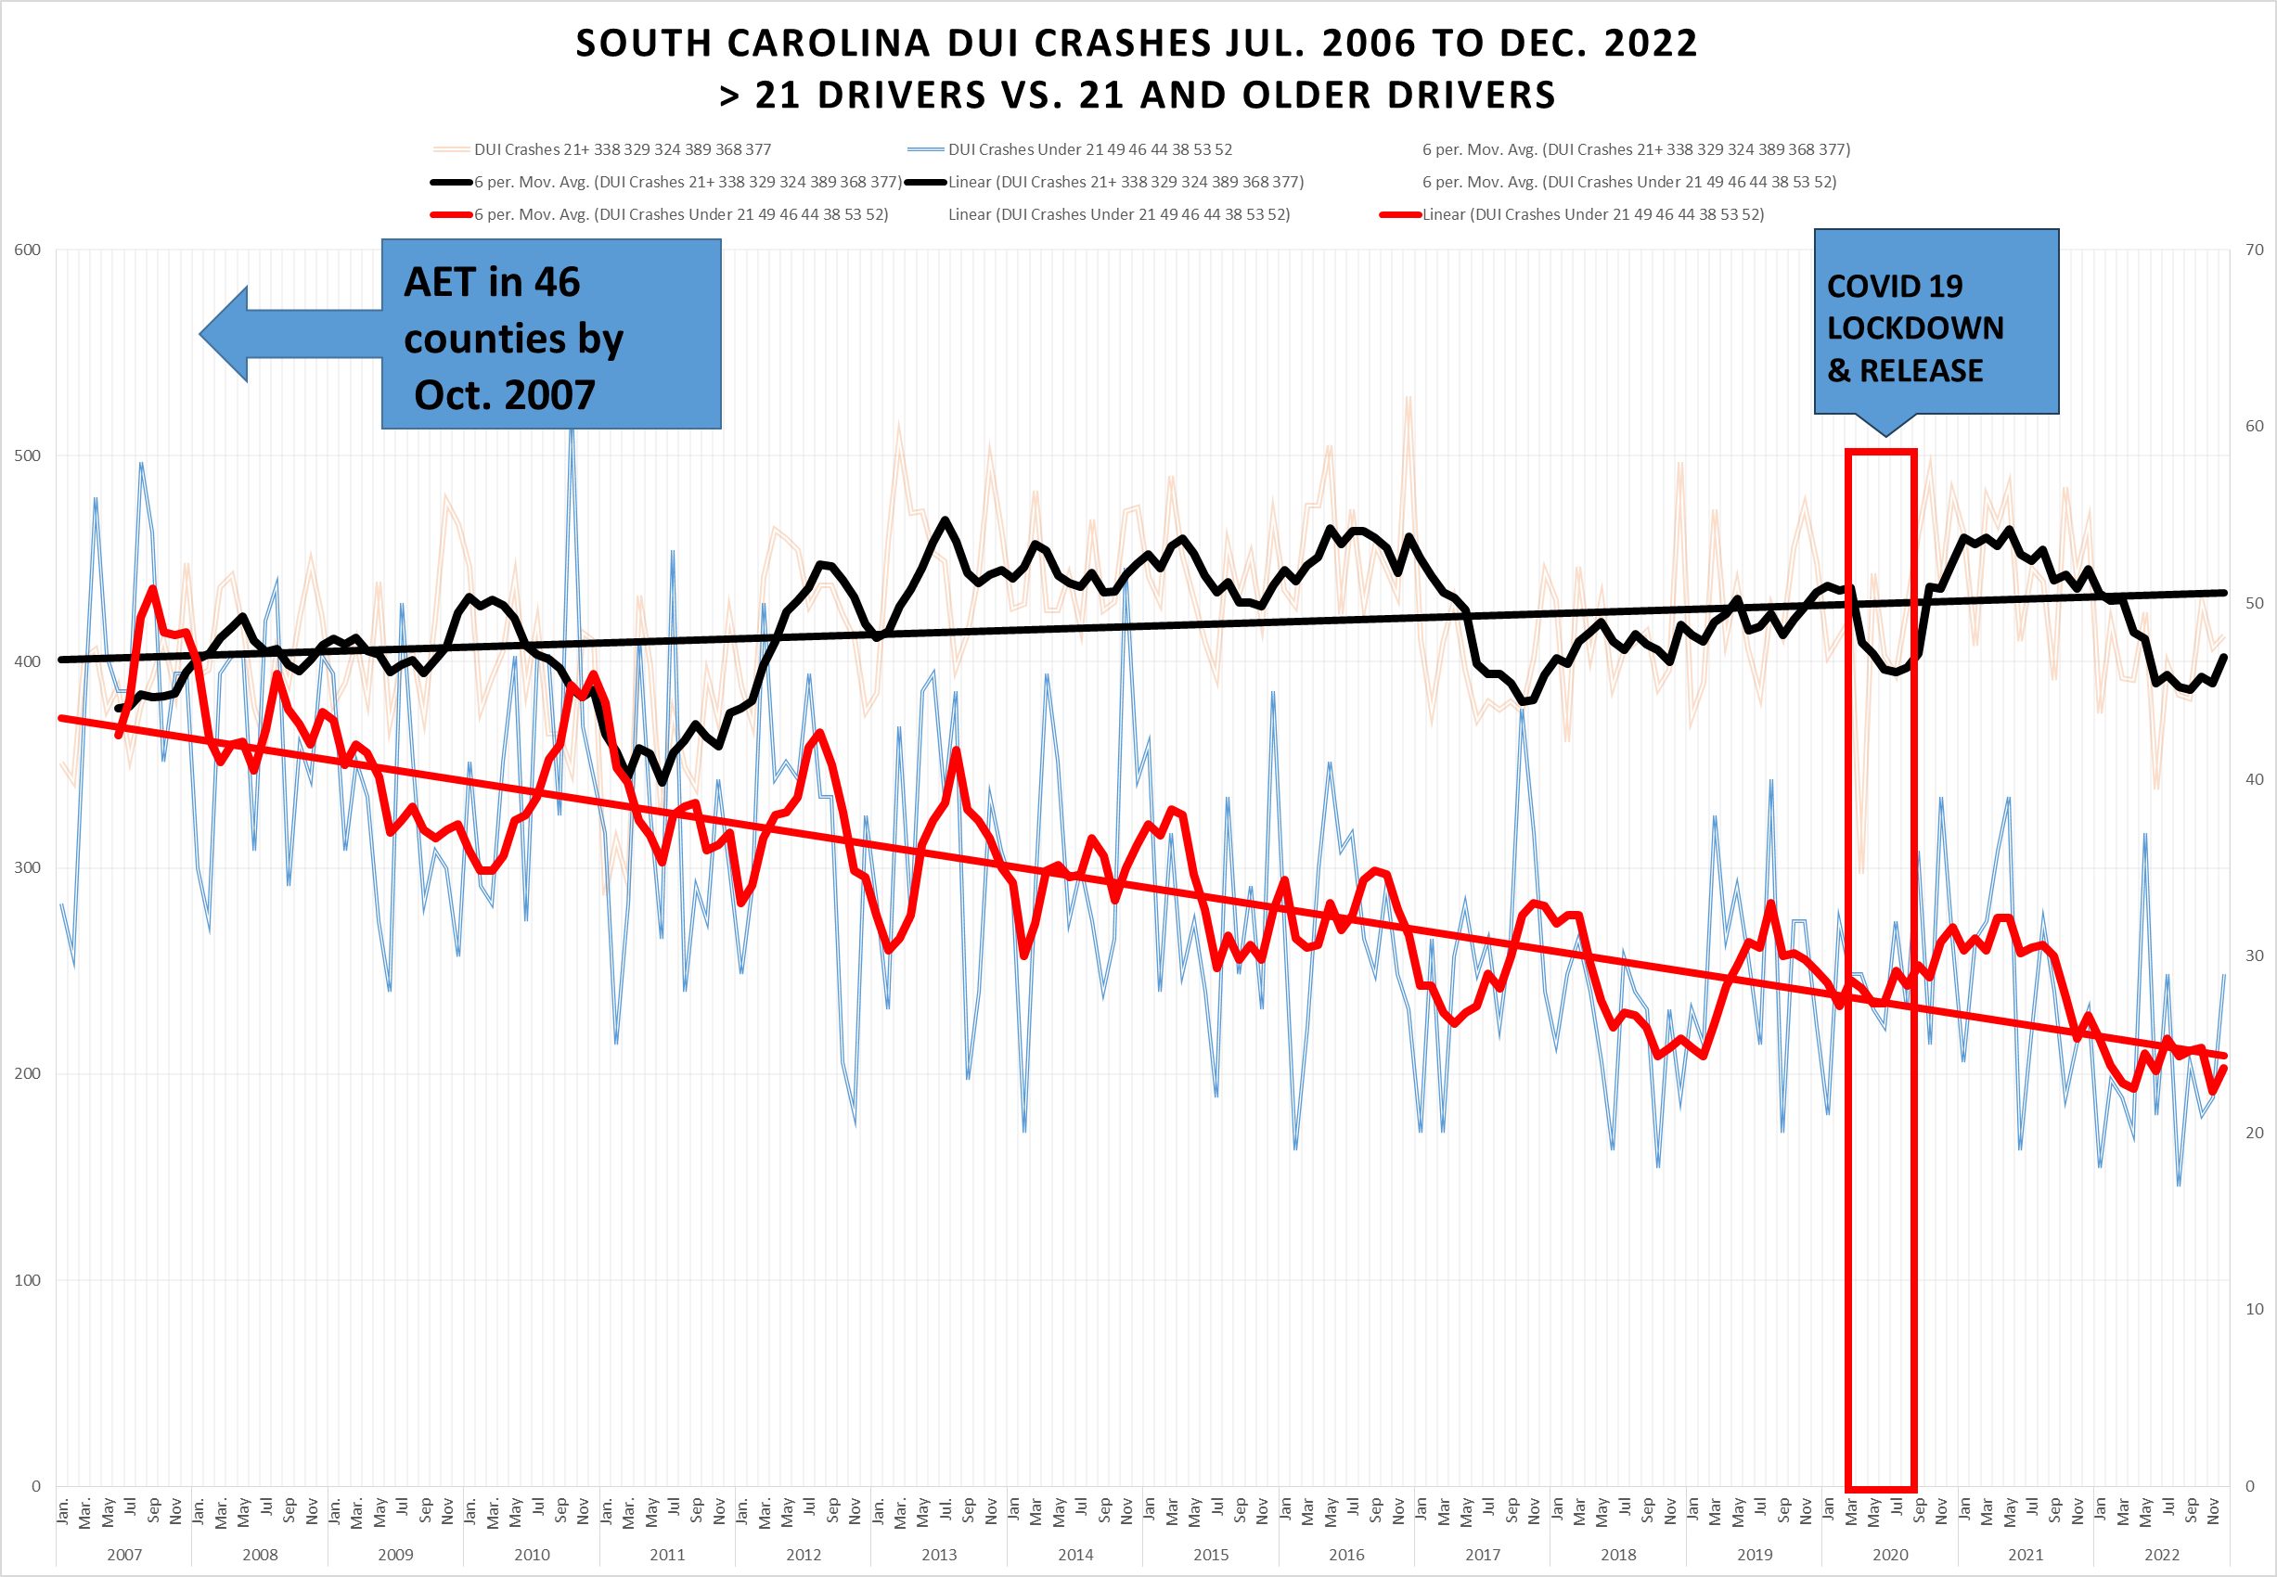

Slide 34
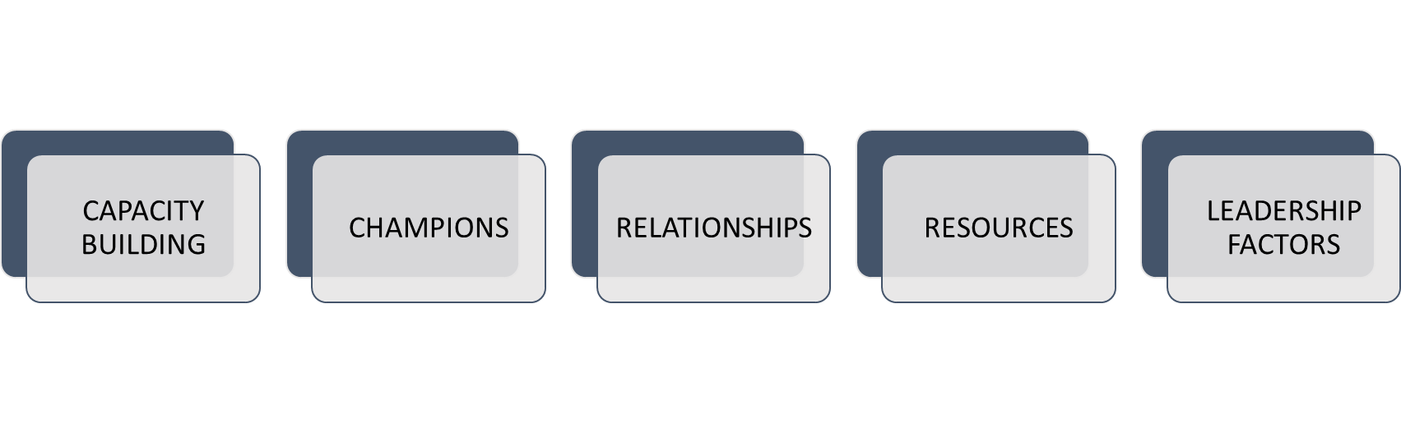
What facilitated South Carolina collaboration through COVID-19 pandemic?
George, M. D. (2016). A study of collaborative leadership in South Carolina Alcohol Enforcement Teams. (Ph.D. Doctoral Dissertation). Walden University, Ann Arbor. ProQuest Dissertations & Theses Global database. (1799913739)

Slide 35
Presentation Objectives Summary
Comprehend the results of the process and outcome evaluations for the South Carolina Alcohol Enforcement Teams (SCAET) for state fiscal years 2006 (July 1, 2006) through 2023 (June 30, 2023).
Know that the alcohol non-compliance rate (buy rate) increased during the COVID-19 lockdown and the subsequent months when law enforcement temporarily paused alcohol compliance checks.
Learn about developing and maintaining a long-term, productive relationship between local and state prevention and law enforcement agencies.
Ascertain the process required to build a statewide underage drinking effort with emphasis at the local level.
Understand possible reasons for reduced enforcement and consequential increased buy rate during and after the COVID pandemic.
Learn about environmental strategies meant to reduce underage consumption of alcohol.
Understand that consistent alcohol compliance checks are needed to reduce underage drinking traffic crashes.
Notes:
Section Header Slide

Slide 36
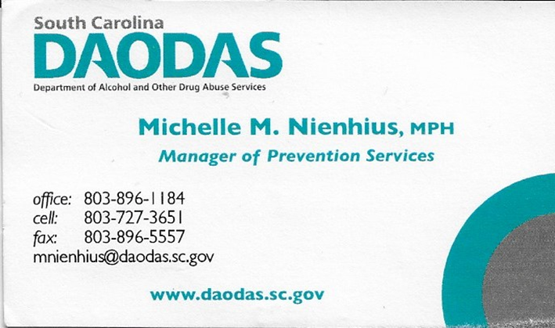
Questions?
Notes:
Q&A Slide

Slide 37

1801 Main Street, 12th Floor • Columbia, South Carolina 29201
telephone: 803-896-5555 • fax: 803-896-5558
www.daodas.sc.gov
Notes:
Final Slide

